Slide 1
Web Basics – HTML 5
Lesson 4. List

Slide 2

Lesson Objectives
In this lesson, you will learn about:
  Numbered List
  Bulleted List
  Glossary List
Notes:
HTML provides support for ordered, unordered and other types of lists

Slide 3
4.1: Numbered List
List of items can be numbered or ordered is called numbered/ordered List
Tags can be used for creating ordered list are:
  <OL>
  <LI>
<LI> tag
  Defines a list item.
  Should be used as a child tag of either <OL> or <UL> tag.
<OL> tag
  <OL> defines an ordered list.
  An ordered list can be numerical or alphabetical.
  Attributes in <OL> tag are
    start
    type
Notes:
Numbered List:
HTML enables you to create a numbered, or ordered list that will automatically generate numbers in front of each item in the list.
The number placed in front of an item depends on the location of the item in the list.
At the beginning of the list, place the <OL> (for ordered list) tag. At the end of the list, place the </OL> tag and in front of each item in the list, place the <LI> (for list item) tag.
End tag for<LI> is optional.

Slide 4
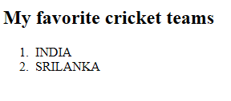
4.1: Numbered List
Example (Code)
Output
<!DOCTYPE html>
<html>
<body>
<h2>My favorite cricket teams</h2>
<ol>
<li>INDIA</li>
<li>SRILANKA</li>
</ol>
</body>
</html>

Slide 5
4.1: Numbered List
Attributes in <OL> tag
Type Attribute:
  Specifies the kind of marked to use in the list
  Valid values for the Type Attribute
    A-Uppercase letters
    a-Lowercase letters
    I-Uppercase Roman letters
    i-Lowercase Roman letters
    1-Standard numbers, default
Start Attribute
  Specifies the start value of an ordered list
Notes:
You can even select the type of numbering system to be used with the type attribute. For example:
A-Uppercase letters: <OL TYPE=A>
a-Lowercase letters: <OL TYPE=a>
I-Uppercase Roman letters: <OL TYPE=I>
i-Lowercase Roman letters: <OL TYPE=i>
1-Standard numbers: <OL TYPE=1>
Type attribute enables you to alter the style of numbers used in the lists, whereas start attribute sets the starting number of the list.
To start an ordered list at a number other than 1, place the START attribute on the <OL> tag at the beginning of the list.
You can also use the VALUE attribute within <LI> tag to change the numbering sequence within a list.

Slide 6
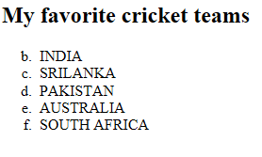
4.1: Numbered List
Example
Output
Example:
<!DOCTYPE html>
<html>
<body>
<h2>My favorite cricket teams<h2>
<ol start="2" type="a">
<li>INDIA
<li>SRILANKA
<li>PAKISTAN
<li>AUSTRALIA
<li>SOUTH AFRICA
<ol>
</body>
</html>

Slide 7
4.1 Numbered List
NumberedList.html

Slide 8
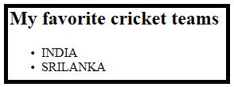
4.2: Bulleted List
Bulleted List
List of items prefixed with bullets is called Bulleted /Unordered List
<UL> tag
  <OL> defines an unordered list.
  An unordered list items will be marked with bullets (small black circles).
Example
Output
<!DOCTYPE html>
<html>
<body>
<h2>My favorite cricket teams</h2>
<ul>
<li>INDIA</li>
<li>SRILANKA</li>
</ul>
</body>
</html>
Notes:
To create a bulleted list use the <UL>(unordered list) tag at the opening of the list and </UL> at the end of the list.

Slide 9
4.2: Bulleted List
Attributes in <UL> tag
Style Attribute:
  Can be used in <UL> tag to define the style of the marker.
Example
  <UL style=“list-style-type:circle”> will be used to prefix unordered list of items with square.
Style Attribute Value | Description
list-style-type:disc | The list items will be marked with bullets (default)
list-style-type:circle | The list items will be marked with circles
list-style-type:square | The list items will be marked with squares
list-style-type:none | The list items will not be marked
list-style-image: url(‘logo.gif'); | The list items will be marked with an image

Slide 10
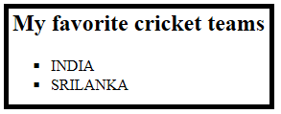
4.2: Bulleted List
Example (Code):
Output
Example
  <!DOCTYPE html>
  <html>
  <body>
  <h2>My favorite cricket teams</h2>
  <ul style="list-style-type:square">
  <li>INDIA</li>
  <li>SRILANKA</li>
  </ul>
  </body>
  </html>

Slide 11
4.2 Bulleted List
BulletedList.html

Slide 12
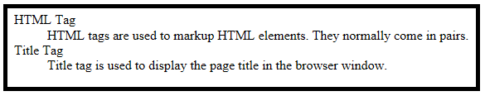
4.3: Glossary List
Glossary List
List of terms, with a description of each term is called Glossary/ Description Lists.
Tags can be used for creating glossary list are:
  <DL> tag: Defines a description list.
  <DT> tag: Defines the term (name).
  <DD> tag: Defines the data (description).
Example for Glossary/Description List:
Notes:
Glossary List:
In the given example, term is defined using <DT> tag are:
HTML Tag
Title Tag
In the given example, defined data are:
HTML tags are used to markup HTML elements. They normally come in pairs.
Title tag is used to display the page title in the browser window.

Slide 13
4.3: Glossary List
Glossary List (Code)
<!DOCTYPE html>
<html>
<body>
<dl>
<dt>HTML Tag</dt>
<dd>HTML tags are used to markup HTML elements. They normally come in pairs. </dd>
<dt>Title Tag</dt>
<dd>Title tag is used to display the page title in the browser window.</dd>
</dl>
</body>
</html>

Slide 14
4.3 Glossary List
GlossaryList.html

Slide 15

Lab
Lab 4

Slide 16

Lesson Summary
In this lesson, you have learnt about:
  Types of available list items
  Create bulleted, numbered and glossary listed items

Slide 17

Review Question: Questions
Question 1:Which tag is used at the beginning of an Ordered List
  <OL>
  <UL>
  <LI>
Question 2:To create a bulleted list <UL> tag is used
  True/ False
Question 3:__________ attribute is used to modify the appearance of bullets
Notes:
Answers:
Question1: <ol>
Question 2: True
Question 3:

Slide 18
Review Question: Match the Following
1. <dd>
2. <dt>
3. <OL TYPE=I>
4. <OL TYPE=A>
5. <OL TYPE=1>
6. <UL style=“list-style-type:circle”>
a. 1-Standard numbers
b. Square Form
c. A-Uppercase letters
d. I-Uppercase Roman letters
e. Data Definition
f. Data Term
Notes:
Answers:
1 – e
2 – f
3 – d
4 – c
5 – a
6 – b

